Slide 1

A* implementation
Andrew Massey

Slide 2

Regret
This project was not what I had hoped it would be. I thought that the concept of implementing A* would be a nice, fun, and easy thing to do. I was wrong.

Slide 3


The Goal
For this project, my goal was to create a randomly generated maze that would allow me to select a start and end point. The maze would then be solved using the A* algorithm.

Slide 4

What is Pygame
Pygame is a library made for python. It is designed to assist people learning python while also making it fun as you are making a game.
I found it incredibly intuitive to use however I did run into a few issues before I learned how much their website helped.

Slide 5
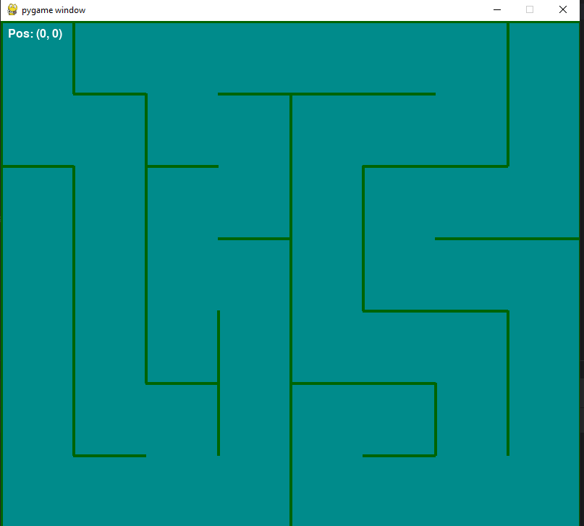
The Maze
This is an example of the maze generated using pygame.
It is generated by starting at the top left corner and moving through the maze picking random spots to put down walls.
The size of the maze can be adjusted to nearly any size.

Slide 6
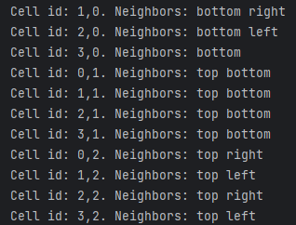
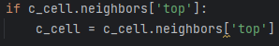
How we can see the walls
This is done by assigning each cell a base of zero open neighbors.
once the maze has fully generated. it adds all of the sides of the cell that do not have a wall to a list called neighbors.
From there, it is as simple as checking the cell that we are currently in for its neighbors and only allowing it to move there.
For example:

Slide 7
Manual Maze Navigation
The first step to implementing A* was to make it so that I myself could solve the maze.
This is fairly straight forward using an “if” statement.
if pressed_keys[pygame.K_UP] and c_cell.neighbors['top']:

Slide 8

Start and End Points
This step was the only vaguely easy part of this whole project.
All I had to do was use the pygame library to record where I click with my mouse and then convert the x and y coordinates of my mouse to the center of the cell that I clicked in.
I then drew a circle at the point clicked to remember where I started.

Slide 9
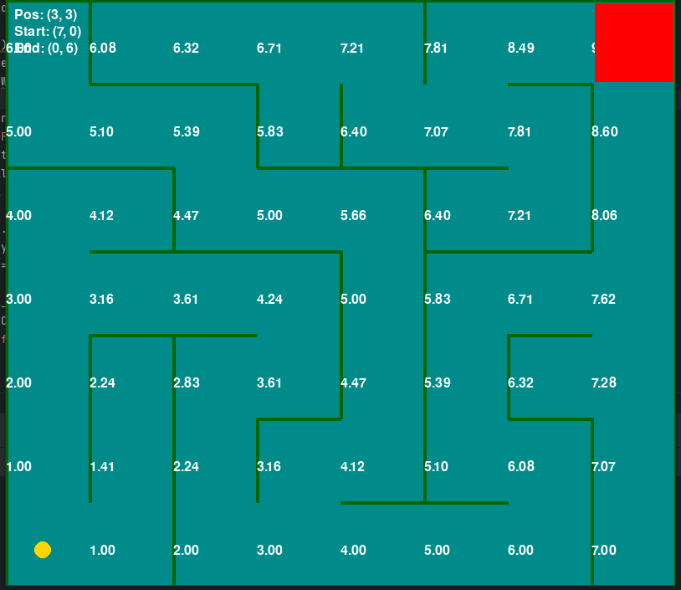
Heuristics
Heuristics is one of the things that would allow my maze to solve itself and choose the best path.
It is the Euclidian distance that each cell is away from the cell that I select as the goal.

Slide 10
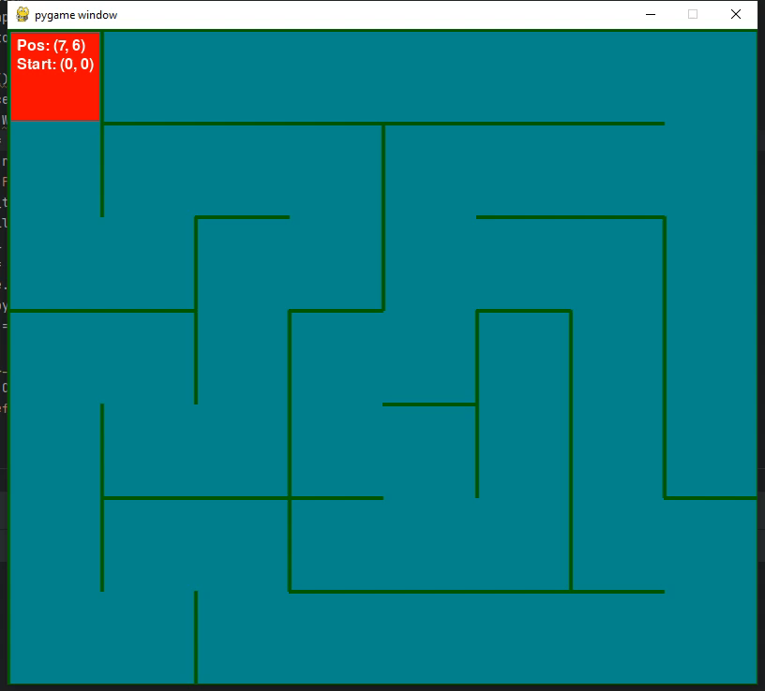
Desperation
Because of my struggles to properly implement A* I had to resort to some “sillier” methods of attempting to solve the maze.
The method you see to your left will pick a random neighbor and go there.
It technically has a 100% success rate however, it sometimes takes a very long time.

Slide 11
What could have been
While trying to understand how the A* algorithm works, I stumbled across this code that was able to properly solve its own maze. Unfortunately, I was unable to use it because it operated differently than my maze.

Slide 12
Acknowledgements
Dr. M. Jafari
William Simons
The Internet

Slide 13
References
Coderspace YouTube channel - https://www.youtube.com/watch?v=Ez7U6jU0q5k
A-Star (A*) Search for Solving a Maze using Python (with visualization) - https://levelup.gitconnected.com/a-star-a-search-for-solving-a-maze-using-python-with-visualization-b0cae1c3ba92

Slide 14

Questions?

